Slide 1
Mutation Analysis Visualization
Group 42:
Omar Ismail
Stephen Palagi
Alyssa Seifert
Josh Tranfaglia

Slide 2
OBJECTIVE
User Interface
Display mutants
Mutant groups
Display difference
Easy Summary
Coverage results
Future Direction

Slide 3
USER POINT OF VIEW
Run ./mutation.sh shell script
Open ./file_path/index.html
View visualization

Slide 4
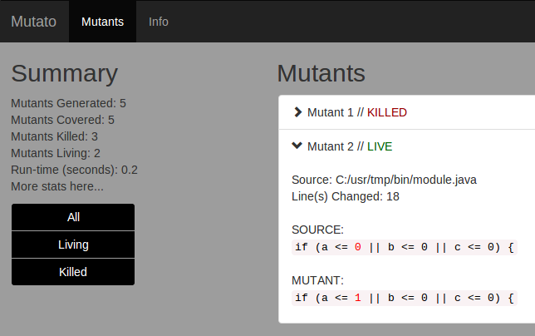
INITIAL MOCKUP
Place your screenshot here
First draft design
Different filters
Live
Killed
Etc.

Slide 5
BACKEND WORK
Create Shell Script
Take Mutation results in
Save data to readable file
Read into HTML/Javascript app
Displayed in the app

Slide 6
THANKS!
Any questions?

Slide 7
CREDITS
Special thanks to all the people who made and released these awesome resources for free:
Presentation template by SlidesCarnival
Photographs by Death to the Stock Photo (license)

